Slide 1
Human Action Recognition with Graph Convolutional Network
Yonggyu Park
19.02.21

Slide 2
Context
Graph Convolutional Network
Human Action Recognition
Dataset
Implement Model
Results
Analysis

Slide 3
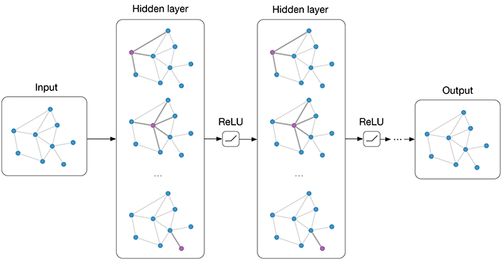
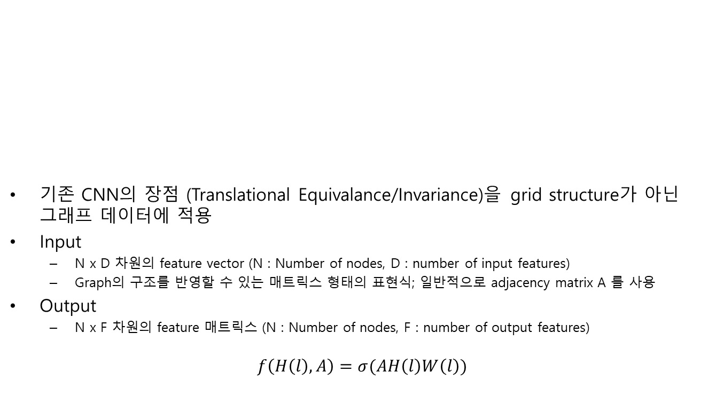
Graph Convolutional Net
기존 CNN의 장점 (Translational Equivalance/Invariance)을 grid structure가 아닌 그래프 데이터에 적용
Input
N x D 차원의 feature vector (N : Number of nodes, D : number of input features)
Graph의 구조를 반영할 수 있는 매트릭스 형태의 표현식; 일반적으로 adjacency matrix A 를 사용
Output
N x F 차원의 feature 매트릭스 (N : Number of nodes, F : number of output features)
$$f\left(H\left(l\right),A\right)=σ(AH\left(l\right)W\left(l\right))$$
Thomas N. Kipf, Max Welling, Semi-Supervised Classification with Graph Convolutional Networks, ICLR 2017.

Slide 4
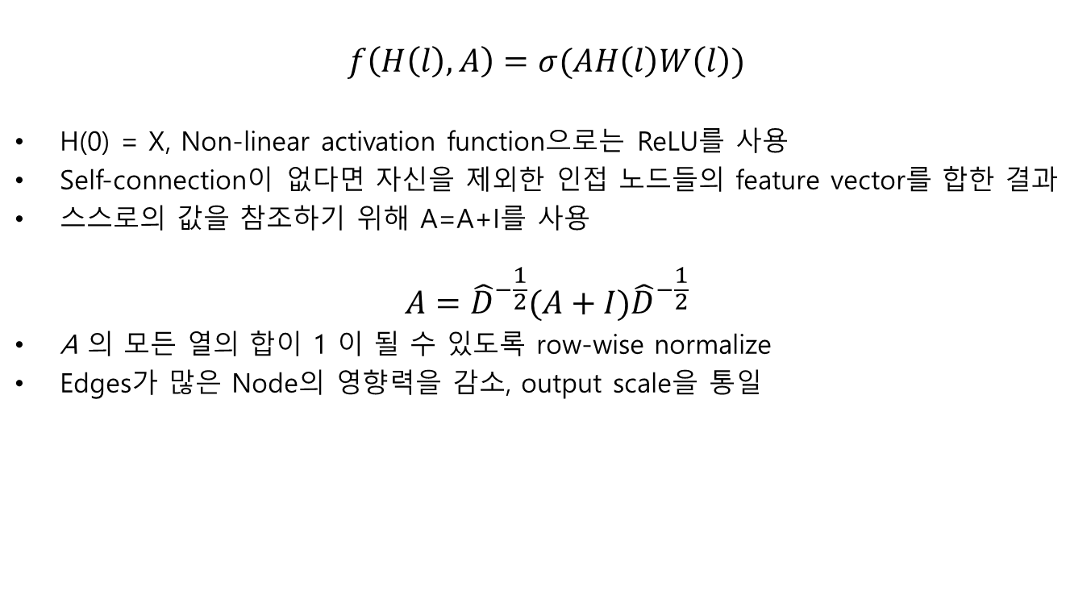
Graph Convolutional Net
$$f\left(H\left(l\right),A\right)=σ(AH\left(l\right)W\left(l\right))$$
H(0) = X, Non-linear activation function으로는 ReLU를 사용
Self-connection이 없다면 자신을 제외한 인접 노드들의 feature vector를 합한 결과
스스로의 값을 참조하기 위해 A=A+I를 사용
$$A={\hat{D}}^{−\frac{1}{2}}(A+I){\hat{D}}^{−\frac{1}{2}}$$
A 의 모든 열의 합이 1 이 될 수 있도록 row-wise normalize
Edges가 많은 Node의 영향력을 감소, output scale을 통일

Slide 5
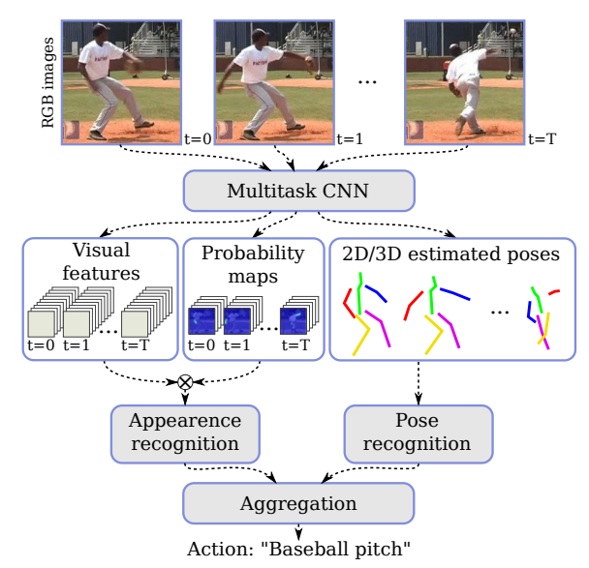
Human Action Recognition
RGB to 2D/RGB-D to 3D skeleton
Baselines : Temporal / Spatial stream networks로 구성
Diogo C. Luvizon, 2D/3D Pose Estimation and Action Recognition using Multitask Deep Learning, CVPR 2018.

Slide 6
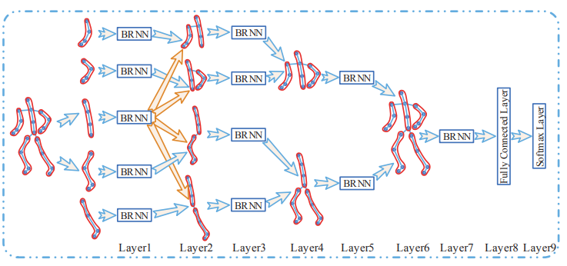
Human Action Recognition
Hierarchical Recurrent Neural network for Skeleton Based Action Recognition, CVPR 2015.
Spatial: body part based features
Temporal: recurrent networks

Slide 7
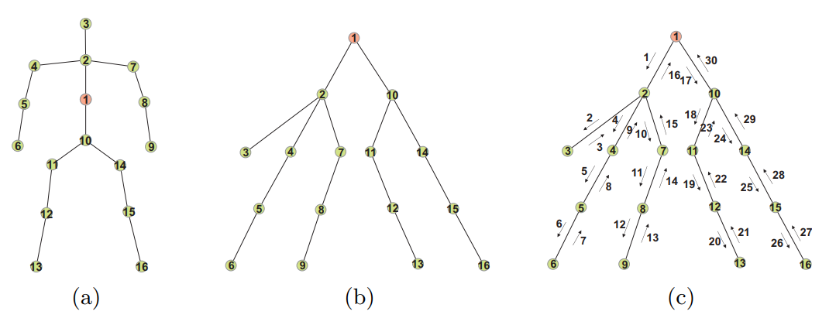
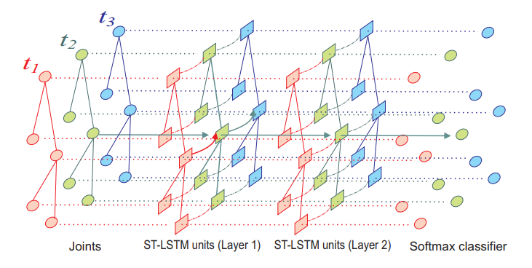
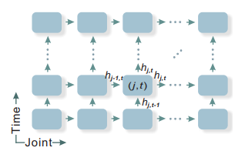
Human Action Recognition
Spatio-Temporal LSTM with Trust Gates for 3D Human Action Recognition, ECCV 2016.
Combination of spatial and temporal features using LSTM

Slide 8
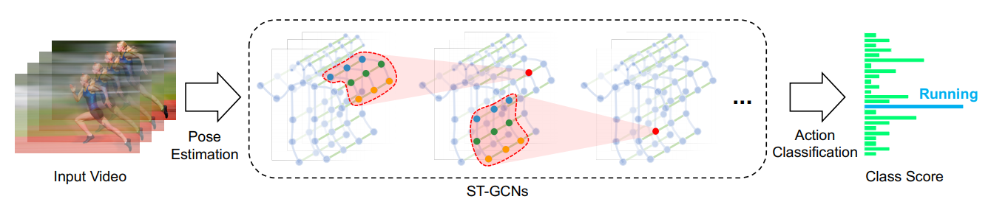
Human Action Recognition
Spatial Temporal Graph Convolutional Networks for Skeleton-Based Action Recognition, Sijie Yan, Yuanjun Xiong and Dahua Lin, AAAI 2018.
실제 사람을 베이스로 Spatial connection 연결
연속된 K개의 프레임의 그래프들을 하나의 그래프로 취급
다른 시간대의 같은 관절들을 Temporal connection으로 연결

Slide 9
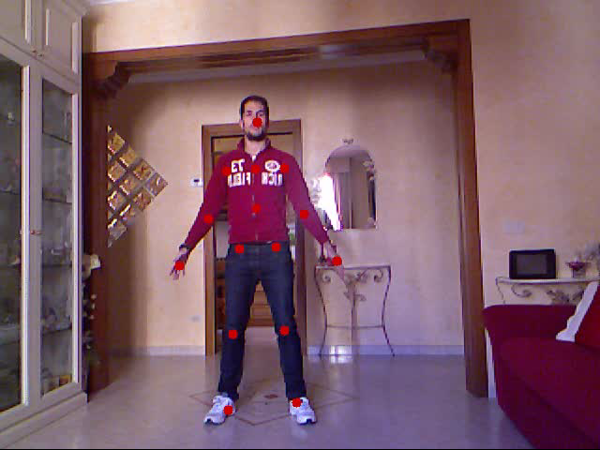
Dataset
Florence 3D actions dataset
215 video, 10 actors: train/valid/test for 8/1/1
9 activities: wave, drink from a bottle, answer phone, clap, tight lace, sit down, stand up, read watch, bow
15 joints: Head, Neck, Spine, Left Shoulder, Left Elbow, Left Wrist, Right Shoulder, Right Elbow, Right Wrist, Left Hip, Left Knee, Left Ankle, Right Hip, Right Knee, Right Ankle

Slide 10
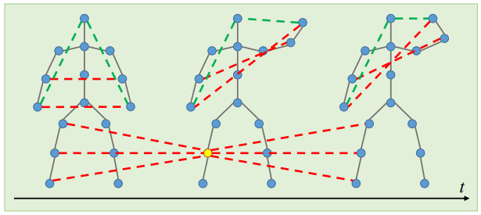
Model
Number of parameters : 26250
Size of model : 569MiB
Time for train : 2 mins for 30 epochs
2-hop Edges
Xiang Gao, Generalized Graph Convolutional Networks for Skeleton-based Action Recognition, Arxiv 2018.

Slide 11
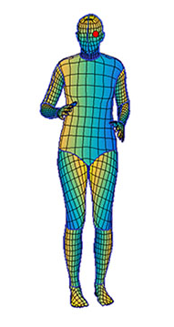
Model
Terminal node embedding
Characterizing of terminal node (head/wrists/ankles)
Linear Interpolation to other nodes
Data Augmentation
Axis rotation (x-z, y-z)
Left-Right rotation
Riza Alp Guler, DensePose: Dense Human Pose Estimation In The Wild, ECCV 2018.
Seungryul Baek, Augmented Skeleton Space Transfer for Depth-based Hand Pose Estimation, Arxiv 2018.

Slide 12
Results
Accuracy

Slide 13
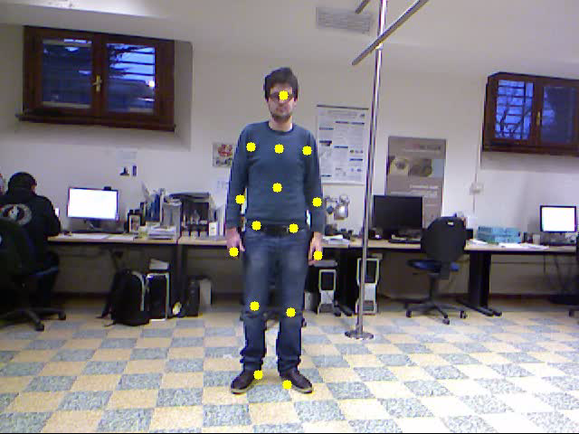
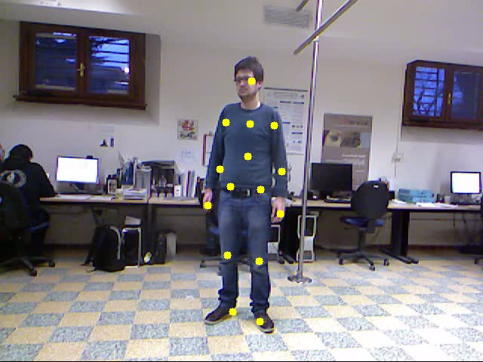
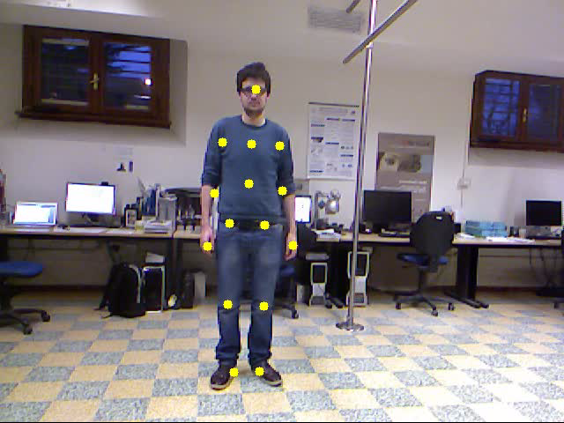
Results
Video
Predict | 3 | 8 | 8
Target | 3 | 3 | 8
Hit | T | F | T
Ratio

Slide 14
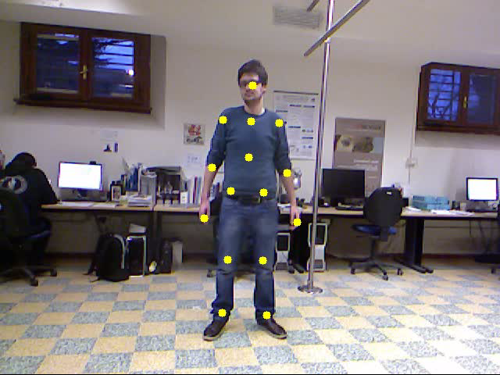
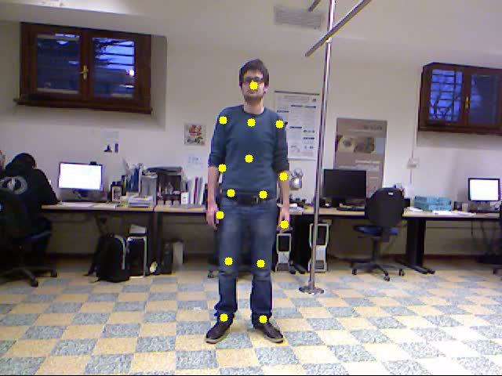
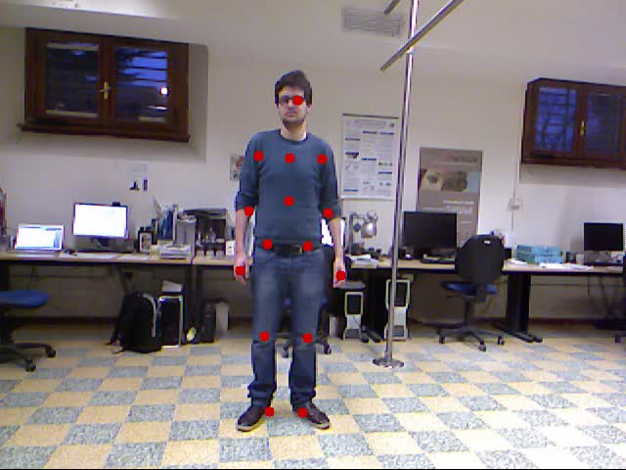
Results
Video
Predict | 8 | 4 | 8
Target | 4 | 4 | 8
Hit | F | T | T
Ratio

Slide 15
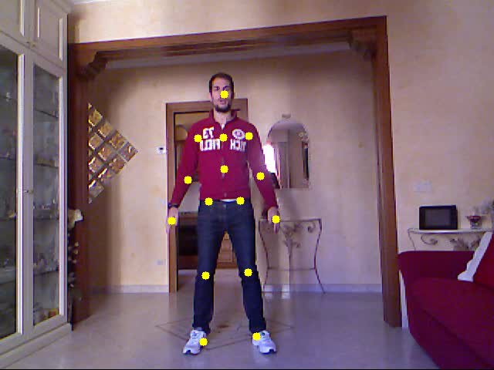
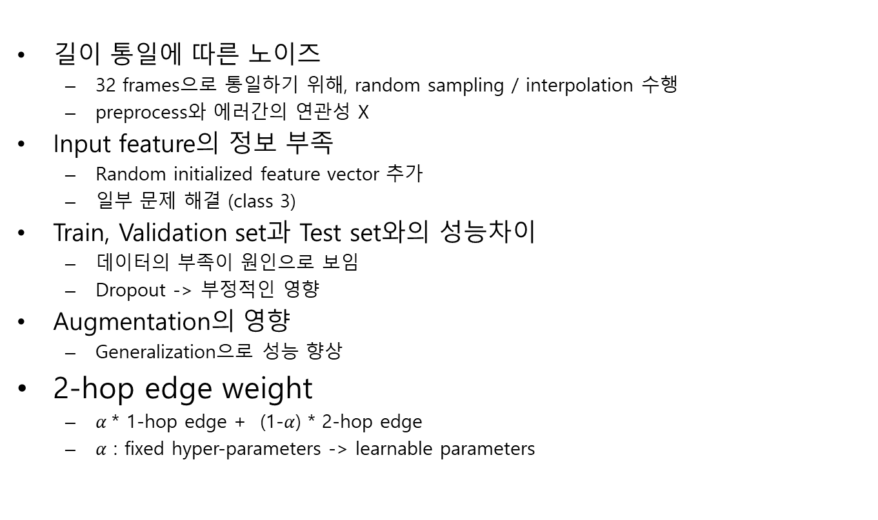
Analysis
길이 통일에 따른 노이즈
32 frames으로 통일하기 위해, random sampling / interpolation 수행
preprocess와 에러간의 연관성 X
Input feature의 정보 부족
Random initialized feature vector 추가
일부 문제 해결 (class 3)
Train, Validation set과 Test set와의 성능차이
데이터의 부족이 원인으로 보임
Dropout -> 부정적인 영향
Augmentation의 영향
Generalization으로 성능 향상
2-hop edge weight
$α$* 1-hop edge + (1-$α$) * 2-hop edge
$α$ : fixed hyper-parameters -> learnable parameters

Slide 16
Appendix

Slide 17
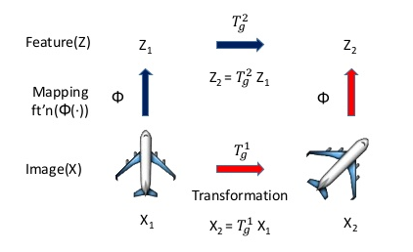
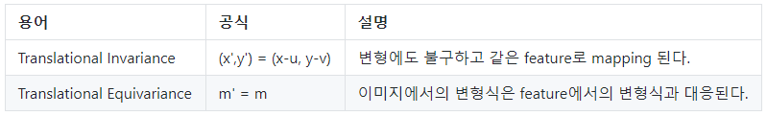
Equivariance / Invariance

